Slide 1
Best practices and tips for learning activities
D-Tasting
4 April 2022

Slide 2
Table of Contents
01
Benefits and challenges
02
Learning formats
03
Practical examples
04
Course Delivery

Slide 3
01
Benefits and challenges

Slide 4
Digital Storytelling: Benefits
Inspires and motivates the audience
01
Inspires and motivates the audience
01
02
Generates and builds knowledge and information, based on the experience of others
Provides the adoption of diverse points of view
03
Provides the adoption of diverse points of view
03
04
Promotes reflective learning
05
Encourages critical thinking
Notes:
https://static1.squarespace.com/static/5475f6eae4b0821160f6ac3e/t/6112a1d280f55667320aed08/1628611032764/09.+Edu+Trends+-+Storytelling.pdf

Slide 5
Digital Storytelling: Challenges
The construction of a coherent narrative
01
The construction of a coherent narrative
01
Design and think a clear path for the character along the content
02
Design and think a clear story for more technical content
02
Notes:
https://static1.squarespace.com/static/5475f6eae4b0821160f6ac3e/t/6112a1d280f55667320aed08/1628611032764/09.+Edu+Trends+-+Storytelling.pdf

Slide 6
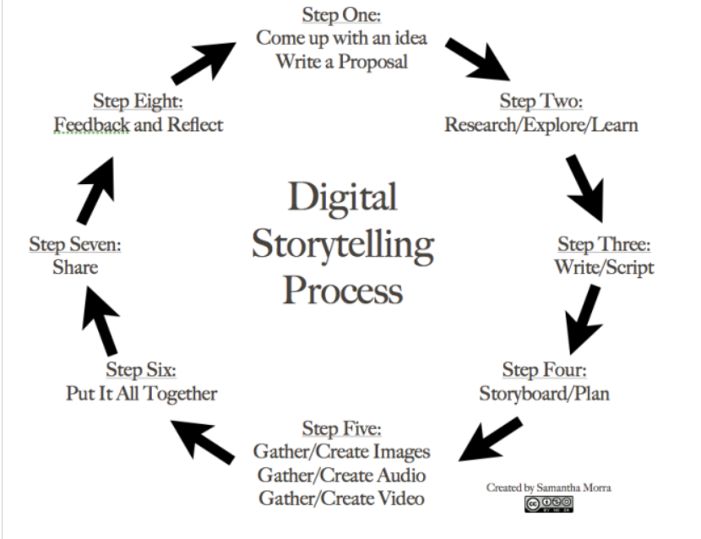
Digital Storytelling

Slide 7
Microlearning: Benefits
01
Learner attention rates go up
02
Easy accessibility increases completion rates
03
Skill gaps close faster
04
Easy to create and update
05
Ideal for the modern learner
Notes:
https://elearningindustry.com/microlearning-in-online-training-5-advantages-and-3-disadvantages

Slide 8
Microlearning: Challenges
01
Not suitable for complex tasks or skills
02
Can easily become fragmented
03
May not help with long-term performance goals
Notes:
https://elearningindustry.com/microlearning-in-online-training-5-advantages-and-3-disadvantages

Slide 9
Experiential Learning (FabLab): Benefits
01
Creates real-world experiences
02
Open more opportunities for creativity
03
Integration of theory and practice
04
Helps in learning mistakes
05
Promotion of communication skills
Notes:
https://elearningindustry.com/microlearning-in-online-training-5-advantages-and-3-disadvantages

Slide 10
Experiential Learning (FabLab): Challenges
01
Requires patience and guidance
02
It is a very support-trainer process
Notes:
https://elearningindustry.com/microlearning-in-online-training-5-advantages-and-3-disadvantages

Slide 11
02
Learning formats

Slide 12
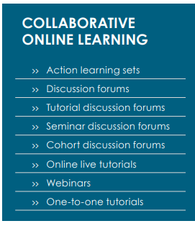
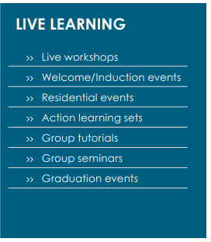

Slide 14
03
Pratical examples

Slide 15
Learning journey - Microlearning
1
3
Storytelling
Exercise
START
FINISH
2
Experiential activity

Slide 16
04
Course Delivery

Slide 17
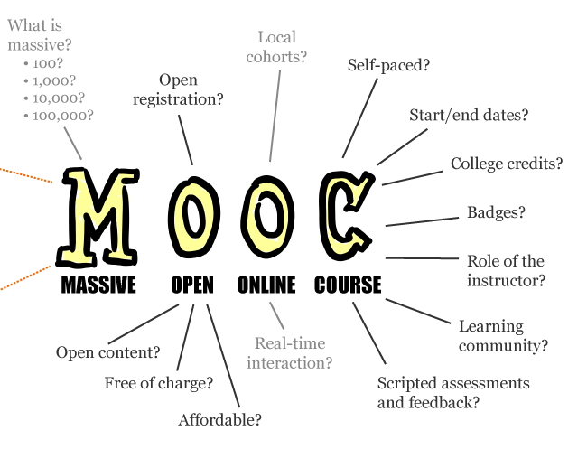
By Mathieu Plourde (Mathplourde on Flickr)

Slide 18
How to Deliver the Course
Go to Major Players
Self-Hosting

Slide 19
What impact do you want to achieve?

Slide 20
Thank You! Let’s talk…
Hugo Domingos
eLearning Unit Coordinator
Maria Silva
eLearning Consultant
Q&A
hugo.domingos@blendedtraining.pt
maria.silva@blendedtraining.pt

